Slide 1
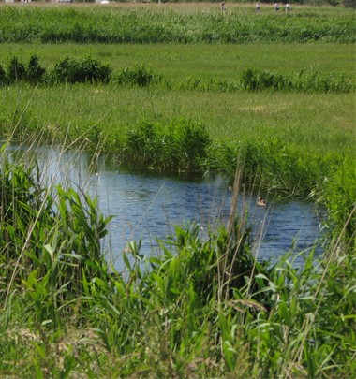
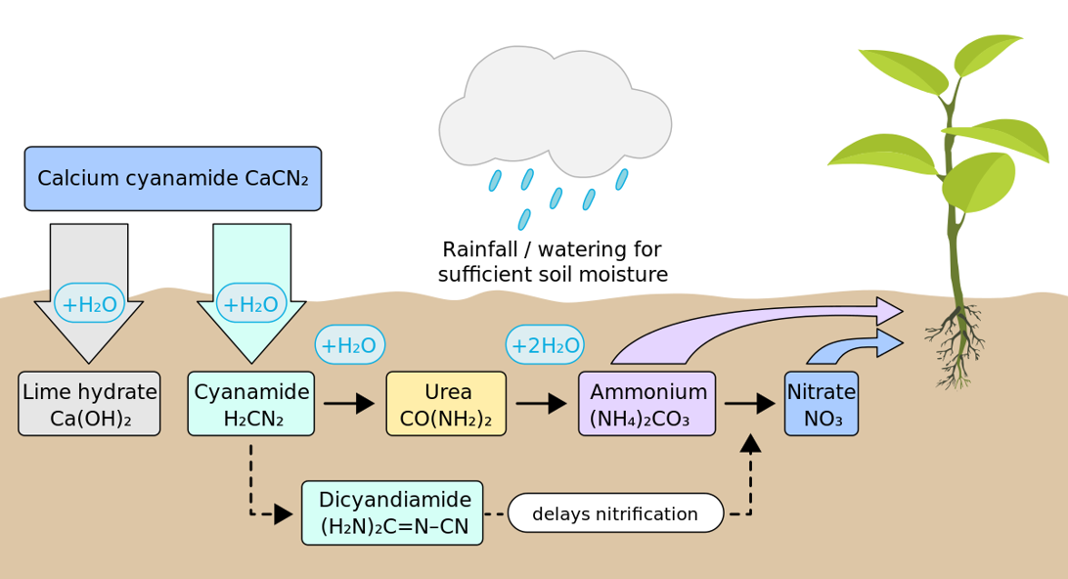
Refined aquatic risk assessment for cyanamide released from Perlka
U. Hommen, 31.05.2018

Slide 2
Motivation
Exposure of organisms in edge-of-field water bodies to cyanamide released from fertilization with Perlka is expected to be rare and pulsed:
    Only onne application of Perlka per year
    Application of granules => no spray drift entries
    In many cases application into the soil => low risk of runoff
Toxicity data are available for a limited number of species and under conservative but unrealistic exposure conditions (i.e. constant concentrations)
Refined effect assessment by testing several taxa under more realistic exposure conditions

Slide 3
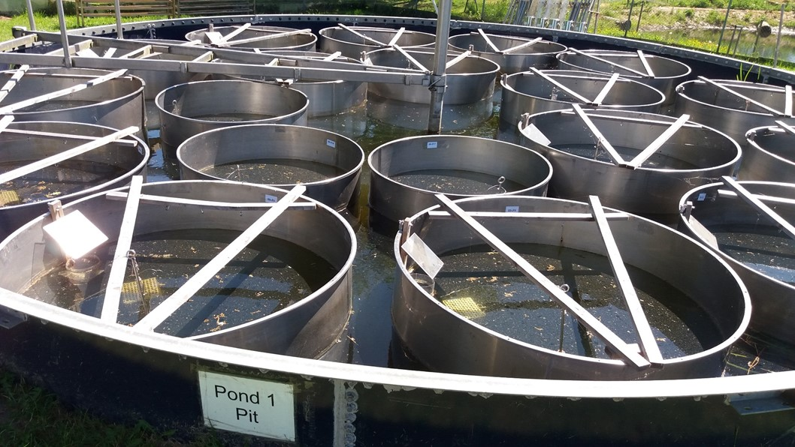
Refinement of PNEC via outdoor model ecosystem study
Benefits
Realistic worst case exposure under outdoor conditions
Testing of a community of many species of different trophic levels (except vertebrates)
Endpoints close to protection goals: population dynamics, ecoystem functions
Inclusion of delayed and indirect effects
Assessment of ecological recovery
Challenges
Complex study
Many data
Variability higher than in standardized lab studies

Slide 4
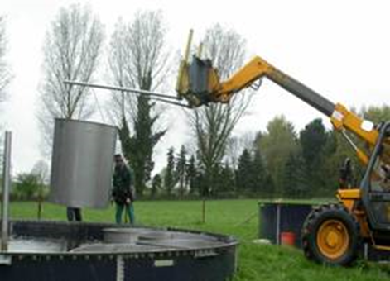
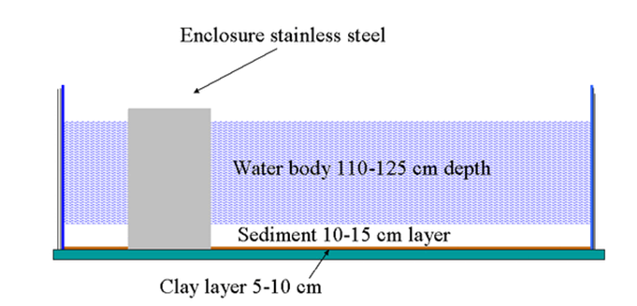
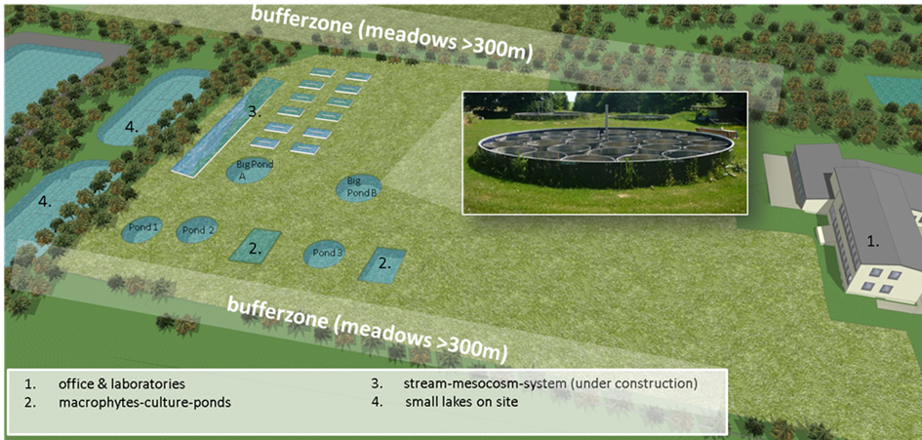
Test site and test systems
Mesocosm GmbH in 35315 Homberg (close to Frankfurt Main, Germany)
Cooperation with Fraunhofer since 2004, > 20 studies until 2017
Test units are enclosures set into an experimental pond
Set up with sediment and water from larger ponds close by in 10.2016

Slide 5
Test design and evaluation
Following OECD guidance on lentic field test, EFSA AGD and Biocide guidance
15 will be used: 5 controls + 5 concentration with 2 replicates each
Univariate evaluation with multiple t-tests (Williams or Dunnett)
Reporting of Minimum Detectable Difference to assess power of the tests
Multivariate analysis of community structure via diversity indices and Principal Response Curves
Effect classification based on statistics and interpretation of dynamics over time and concentration response
Final objective: Derivation of
    Ecological Threshold PNEC
    Ecological Recovery PNEC

Slide 6
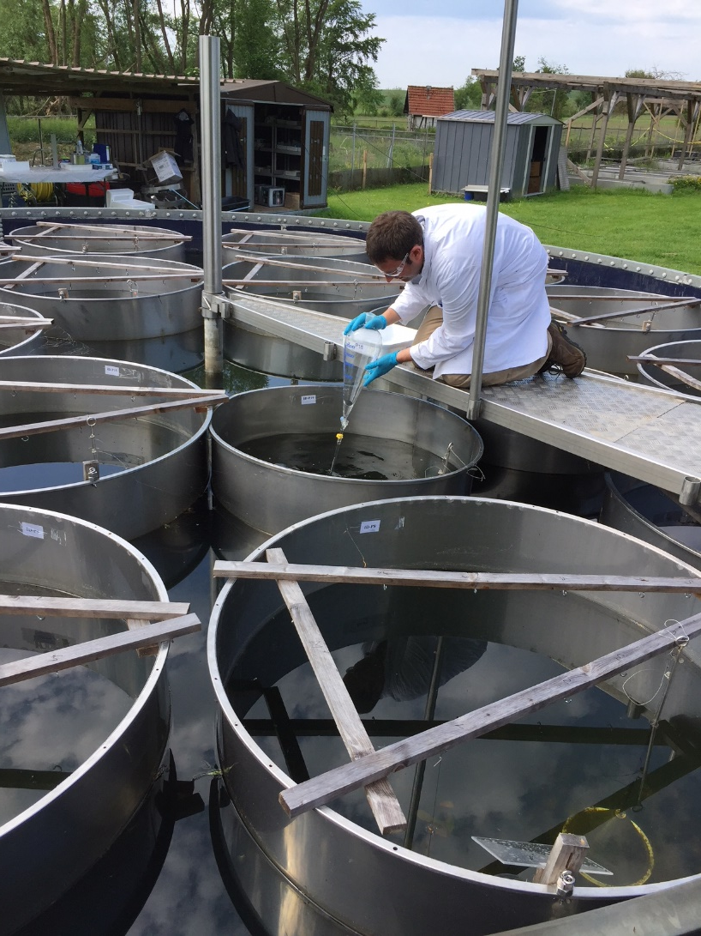
Application
Probably only 1 application in June
2nd application to achieve realistic worst case dissipation depending on exposure modelling and pre-test
Cyanamid test concentrations:
0.03, 0.1, 0.3, 1, 3 µg / L
Application solutions prepared at analytical lab at Fraunhofer IME
Toxicological approach: introduction by moving separation funnel with outlet below water surface
Rinsing separation funnel 3 times with tap water into the enclosure

Slide 7
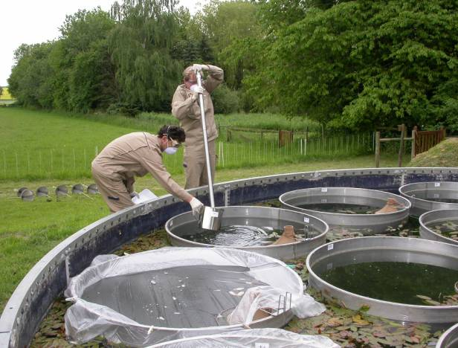
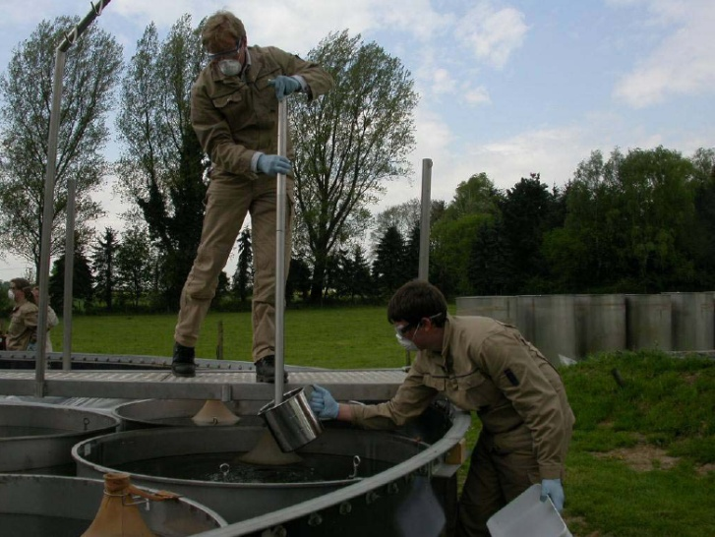
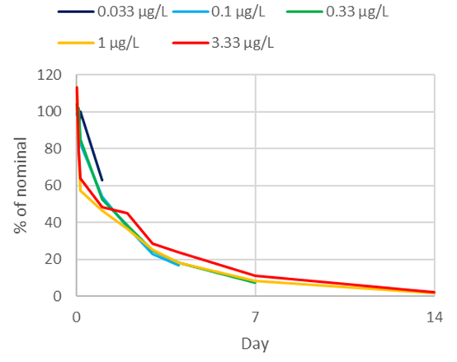
Exposure
Taking water columns at at least 3 locations per enclosure
Take samples for analysis from the pooled samples
Storage deep-fozen until analysis at Fraunhofer IME
LC-MS, intended LOQ = ≤ 0.003 mg/L

Slide 8
Phyto- and zooplankton
Depth integrating samplers
Chlorophyll analysis via delayed fluorescence spectroscopy
Algae identification and counting via inverted microscope
Taxonomic determination and counting of zooplankton
under stereomicroscope
Photo zooplankton sampling?

Slide 9
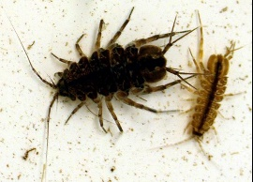
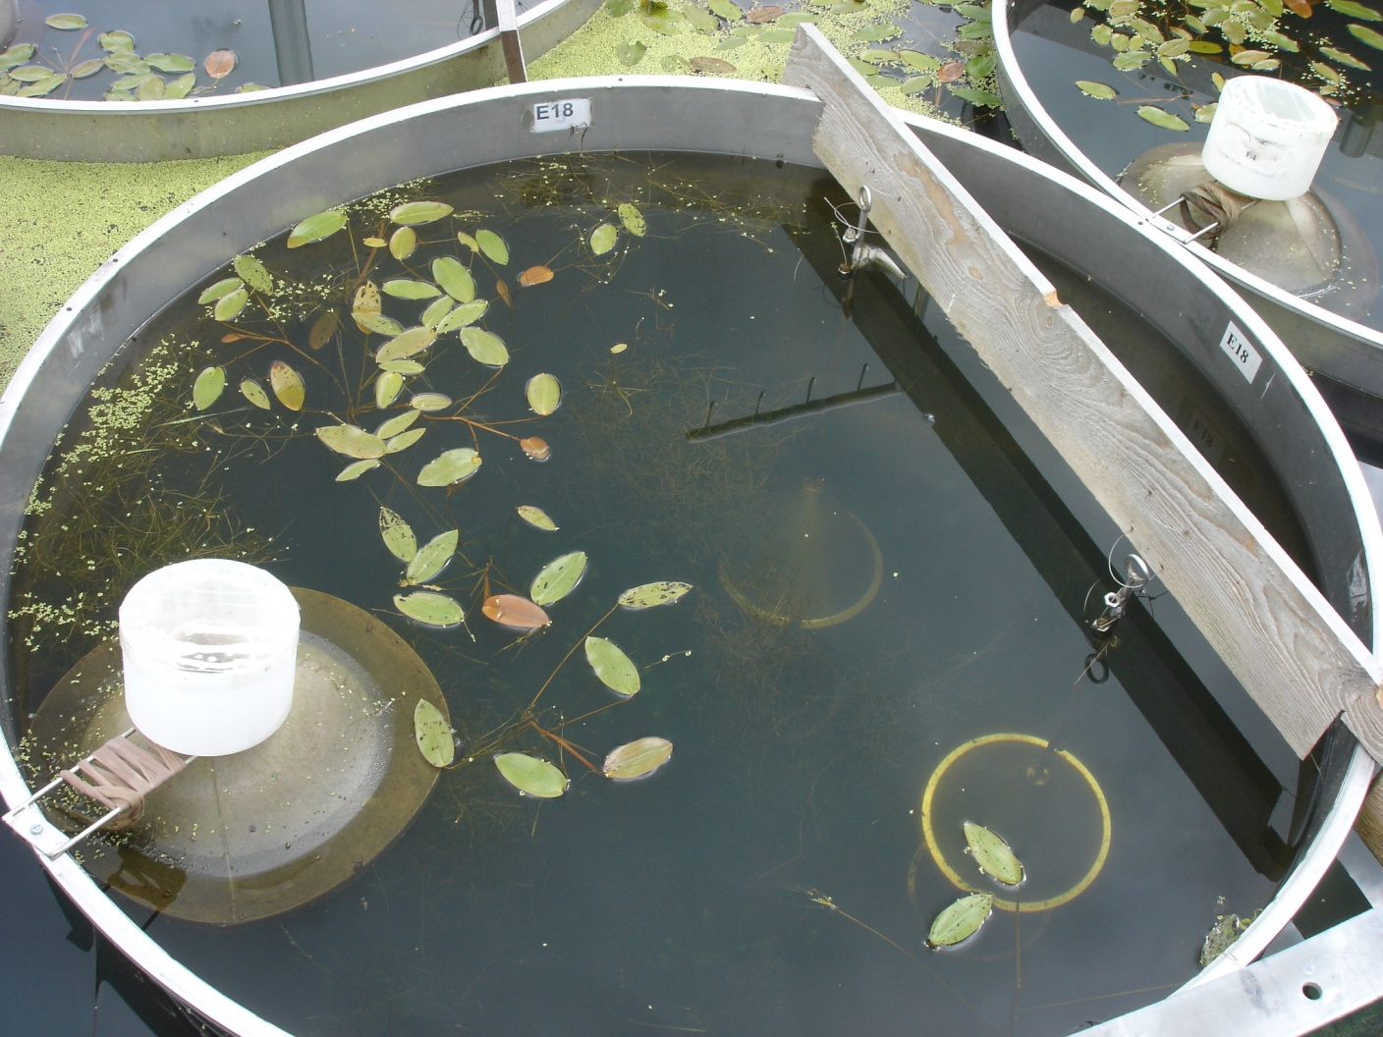
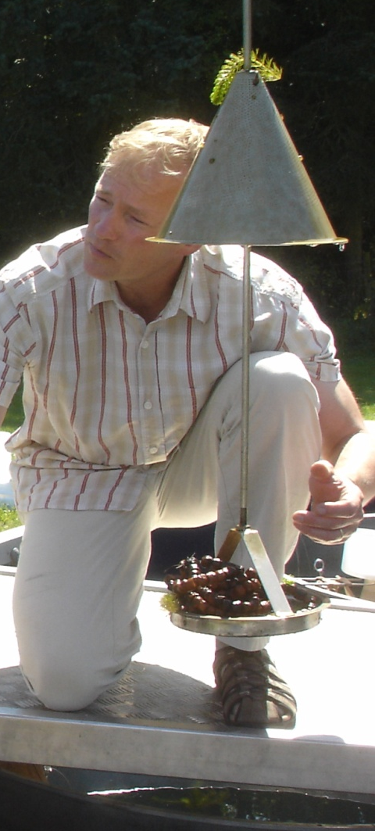
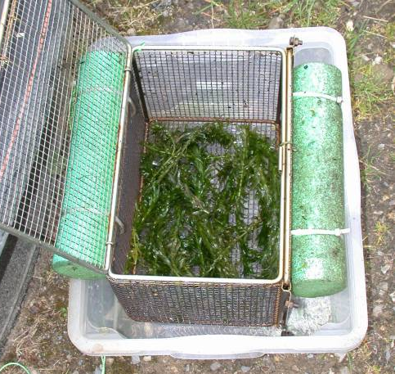
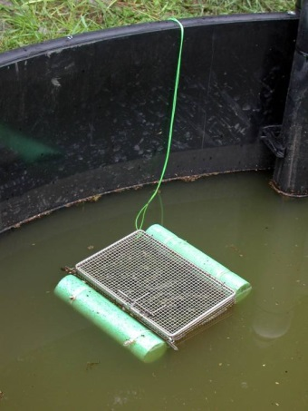
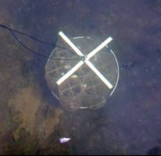
Sampling of macroinvertebrates
Artificial Substrate Sampler
Emergence trap

Slide 10
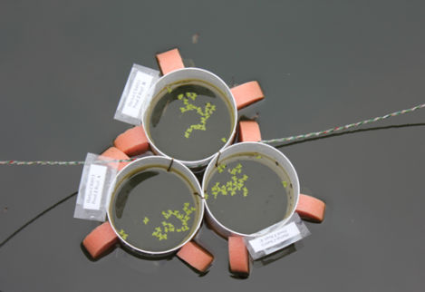
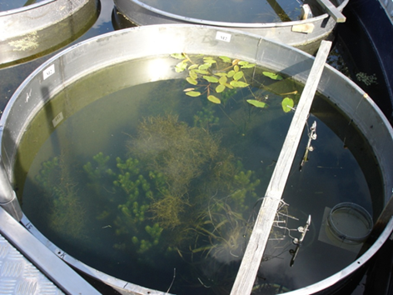
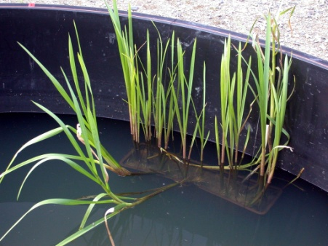
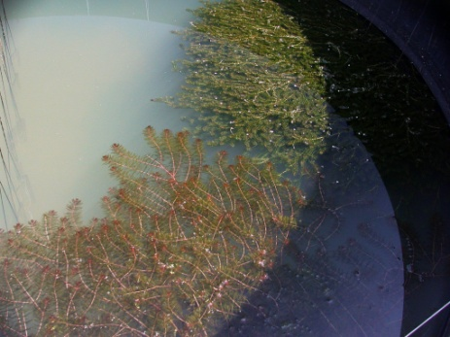
Macrophytes
Ring enclosures for
floated species, e.g.
Lemna
Growing in the sediment
Potted emerged,
e.g. Glyceria
Potted submersed,
e.g. Myriophyllum

Slide 11
Sampling schedule

Slide 12
Effect classification
(EFSA PPR 2013, Brock et al. 2015, ECHA Guidance on BPR 2017)
0 Treatment-related effects cannot be evaluated statistically
1 No treatment-related effect demonstrated (NOECpopulation)
No significance, no clear causal relationship
2 Slight Effect
  Slight or transient effects, short-term or quantitatively restricted response, only observed at individual samplings
3 Pronounced short term effect with recovery
  3A Clear response, but full recovery within 8 weeks after first application (effect period < 8 weeks
  3B Effects longer than 8 weeks but recovery within 8 weeks atter last application
4 Pronounced effect but recovery cannot be assessed
  4A Clear effects, but study too short to demonstrate recovery within 8 weeks
  4B Significant short-term effects but recovery cannot be properly evaluated due to high %MDD
5 Pronounced long term effect
  5A: Recovery within the year of application
  5B: Effects > 8 weeks and no recovery demonstrated before end of the study or start of winter period
Notes:
NOECs < NOEAEC must be presented in order to facilitate interpretation (lack of ecological relevance)

Slide 13
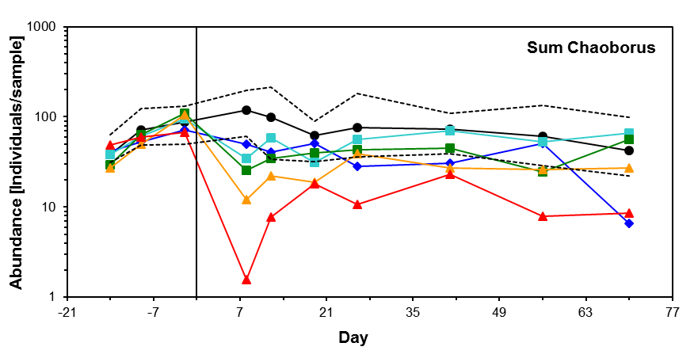
Example effect evaluation
day | NOEC
-14 | 25
-9 | 25
-2 | 25
8 | 5
12 | 5
19 | 7.5
26 | 15
41 | 25
56 | 15
70 | 25
Conc | Effect class
1 | 1
5 | 2
7.5 | 2
15 | 3A
25 | 5B

Slide 14
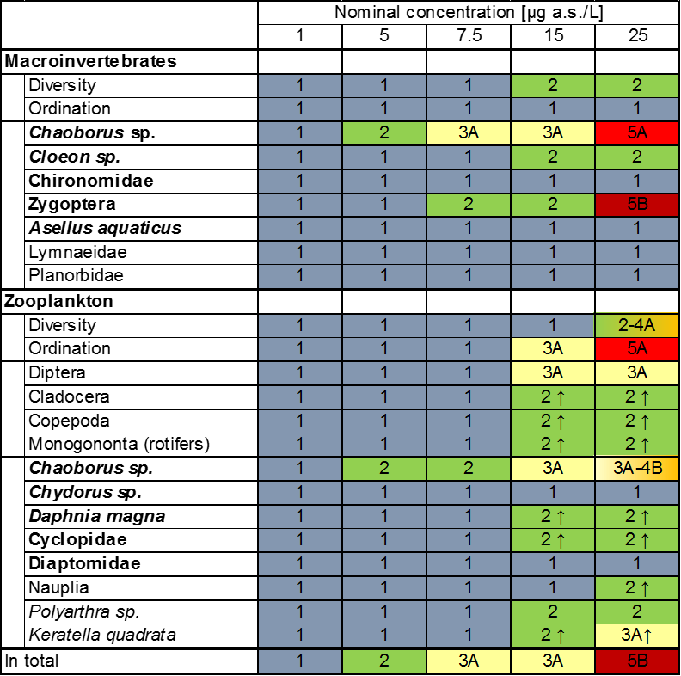
PNEC for Ecological Threshold and Recovery Option
EFSA (2013), ECHA Guidance on BPR (2017)

Slide 15

Thank you very much

