Slide 1
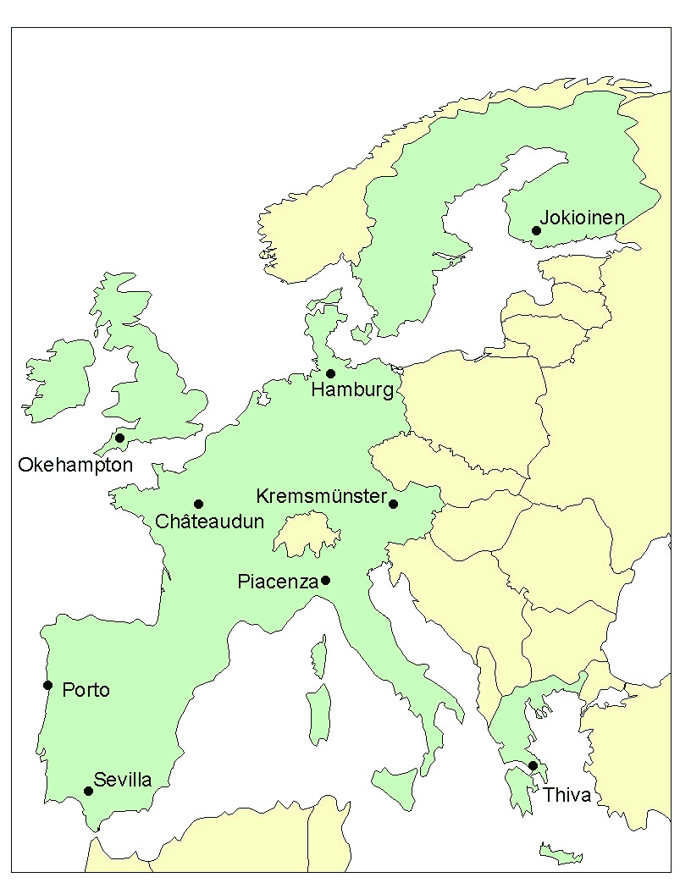

the fate of veterinary compounds in groundwater and surface water modelled by the FOCUS models
Michael Klein
  History and Background of the FOCUS Models
  Description of the scenarios
  Working with the FOCUS models
  (relevant especially for users of the programes)
May 2022

Slide 2
History of FOCUS started in the 90s
FOCUS = (FOrum for the Coordination of pesticide fate models and their USe)
Aim: to develop harmonised Computer models for the ERA of pesticides
FOCUS Steering committee
Modelling of Leaching (1995)
Modelling of Fate in Soil (1997)
Modelling of Surface Water (1996)
FOCUS
Version control
Scenarios for Leaching (2000)
Scenarios for Surface Water (2001)
Landscape and Mitigation (2003)
FOCUSAir (2003)
Deg. kinetics (2001)
Groundwater II (2004)
No more FOCUS groups - FOCUS was „replaced“ by EFSA years ago
(Background: too much industry involvement)

Slide 3
FOCUS models are also useful for veterinary compounds
Generally:
  Though developed for pesticides, the FOCUS models are also valid for veterinary compounds
  chromatographic transport through the soil passage using the convection dispersion equation with sorption to organic carbon as key process
  The FOCUS models do not consider slurry applications
  → rather worst case assumption since possible additional degradation by slurry or adsorption to slurry after application is not considered in the simulation
With regard to the ERA of veterinary compounds:
  The Tier A – methodology for PEC calculation is very simple and represents extreme worst case conditions
  additional refinement using higher tier FOCUS modelling needed in ERA
  The results of the FOCUS models can be used in the same way to calculate risk quotients as done with the Tier A PECs

Slide 4
FOCUS SW and GW Working Groups
Before FOCUS European scenarios did not exist. The working groups got a clear mission from the EU commission how European scenarios should look like:
Produce a limited number of ‘realistic worst-case’ scenarios
(maximum of 10)
Take into account all relevant target crops, topography, soil and climate
Define realistic worst cases statistically if possible
Wherever possible, scenarios should be represented by a specific field site with monitoring data (allows validation)
Check whether selected scenarios are reasonable (no tobacco in Sweden)
Additionally for surface water:
  Scenarios should reflect realistic combinations of run-off and drainage (different processes dominate in different areas).
  Take into account all relevant entry routes and surface water

Slide 5
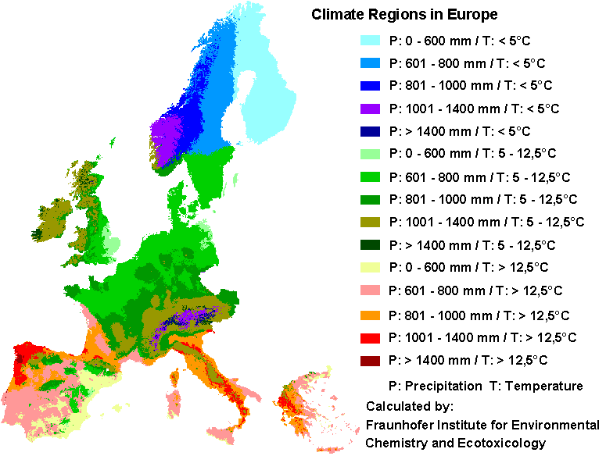
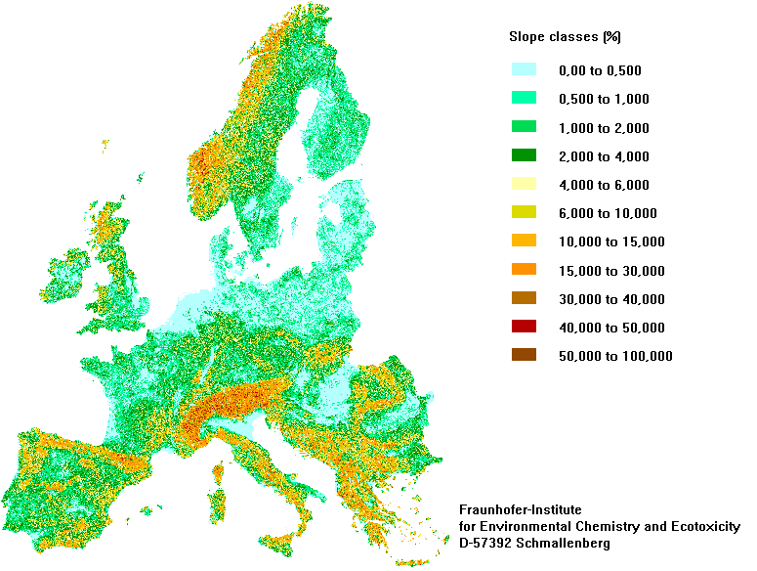
FOCUS groundwater and surface water followed the same criteria
Span range of temperature and rainfall
Pick locations which are representative for major agricultural regions
Distribute locations geographically across EU
Select scenarios which can be represented by a specific field site with monitoring data (in order to be able to later validate model results)

Slide 6
General properties of the FOCUS groundwater (GW) and FOCUS surface water (SW) scenarios

Slide 7
FOCUS groundwater suggested 9 locations
No | Locations | Arable land (%) | Total area (%) | Rainfall (mm) | Temperature (°C)
1 | Châteaudun, Hamburg | 31 | 19 | 601 to 800 | 5 to 12.5
2 | Kremsmünster | 18 | 13 | 801 to 1000 | 5 to 12.5
3 | Okehampton | 15 | 12 | 1001 to 1400 | 5 to 12.5
4 | Sevilla/Thiva | 13 | 11 | 601 to 800 | > 12.5
5 | Piacenza | 9 | 8 | 801 to 1000 | > 12.5
6 | Sevilla/Thiva | 4 | 4 | < 600 | > 12.5
7 | Châteaudun | 3 | 2 | < 600 | 5 to 12.5
8 | Porto | 3 | 3 | 1001 to 1400 | > 12.5
9 | Jokioinen | 1 | 11 | < 600 | < 5
Different proportion of arable land
3 different temperature ranges (cold, moderate, warm)
Combinations of different amounts of rainfall

Slide 8
FOCUS surface water suggested 3 water bodies
3 different water bodies:
Ditch: 2m x 100m x 0.3m, 50 day residence time ^
Pond: 30m x 30m x 1m, 50 day residence time ^
Stream: 2m x 1000m x 0.5m, 1 day residence time^
Detailed geometry of the water bodies are defined dependent on the location
All water bodies are at the edge of the field and relatively small with different residence times
^ Transportation outof the system follows exponential decline. After
passing the residence time the remaining concentration is
therefore 1/e=37% of the intitial concentrations (not 0!)

Slide 9
FOCUS SW suggested 3 entry routes into surface water
Spray drift during application
Runoff after heavy rainfall (via water and particle phase)
Drainage system (only water phase)
For veterinary compounds spray drift is not relevant
(substances are incorporated with slurry)
Scenario locations are split in 4 runoff (R) and 6 drainage (D) locations
Either runoff or drainage was considered as entry route at a given location

Slide 10
SW scenarios are characterised by many parameters
Lanna
Brimstone
Vredepeel
Skousbo
La Jailliere
Thiva
Weiherbach
Porto
Bologna
Roujan
Scenarios differ within temperature, rainfall, recharge, soil properties and slope

Slide 11
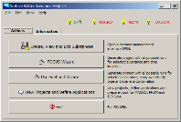
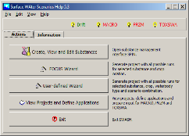
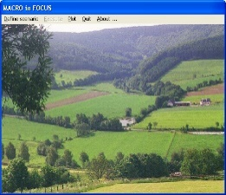
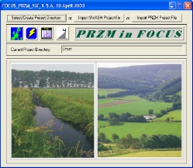
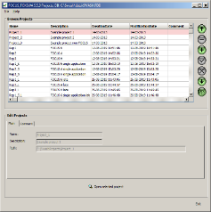
Different models for SW and GW were developed
GW: PEARL (PELMO, MACRO, PRZM)
SW:
SWASH
Drift (SWASH)
Drainage (MACRO)
Run-off (PRZM)
PECsw (TOXSWA)
Parallel models were developed for GW, whereas a sequence of models was developed for SW

Slide 12
Models are different but based on similar theory
Simulations are always complex and based on numerical solutions (no analytical models)
All models use time steps, at least of 1 day for the calculation
The models have user friendly shells
  To prevent mistakes by the user
  To support interpretation of results
The groundwater model (FOCUS PEARL) runs over a period of 20years and calculates the 90th percentile of annual concentrations in groundwater
The surface water model calculates maximum and time weighted concentrations (TWA) over a period of 1 year.

Slide 13
FOCUS models are freely available
Download link:
https://esdac.jrc.ec.europa.eu/projects/focus-dg-sante
The link includes installation packages and manuals
Most recent versions of the models:
Groundwater: FOCUS PEARL version 5.5.5
Surface water:
  FOCUS SWASH version 5.3
  Spin database version 3.3
  FOCUS MACRO version 5.5.4
  FOCUS PRZM version 4.3.1
  TOXSWA version 5.5.3

Slide 14
Working with FOCUS PEARL version 5.5.5
(Groundwater model)

Slide 15
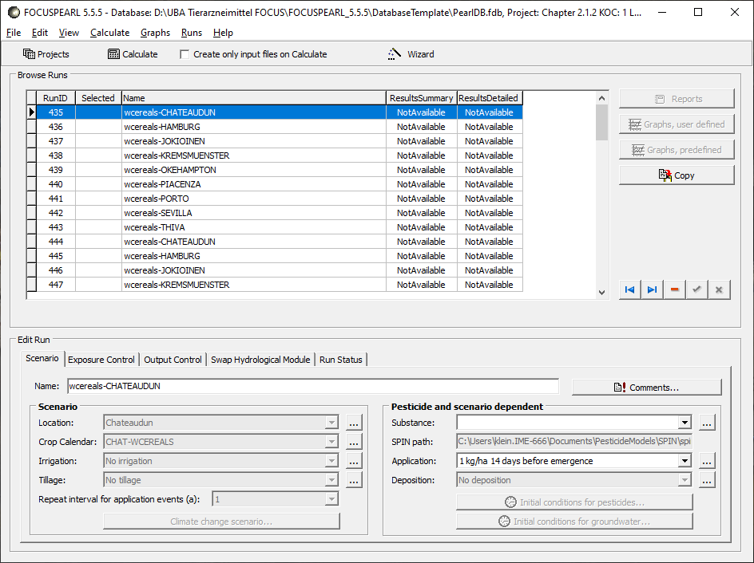
In order to run simulations a fixed sequence has to be followed
4
3
5
Define a substance
Define an application
Create a new project
Start calculation
Find the results
1
2
The setting of all input parameters is also described in
https://www.ema.europa.eu/en/environmental-impact-assessment-veterinary-medicinal-products-sup-port-vich-guidelines-gl6-gl38

Slide 16
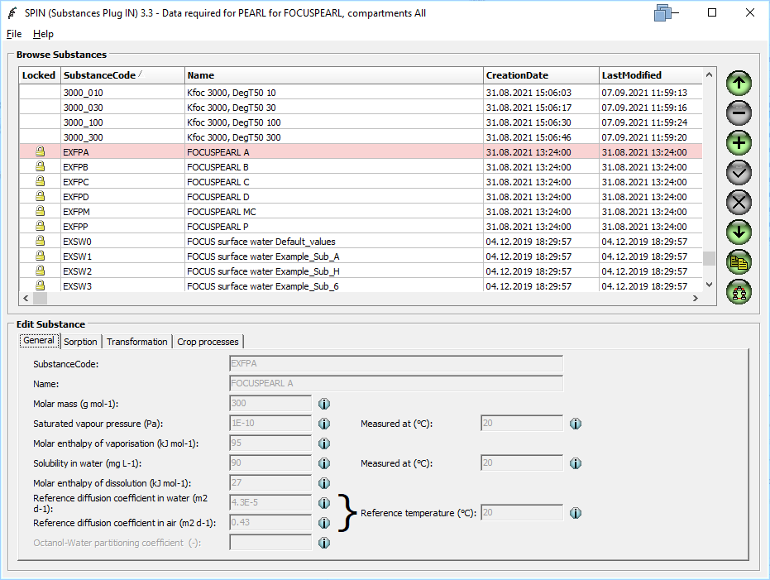
1. Define a substance – general data
First Copy a record (e.g., EXFPA) and then enter the PC-Data (molar mass, vapour pressure and water solubility). Keep default values.

Slide 17
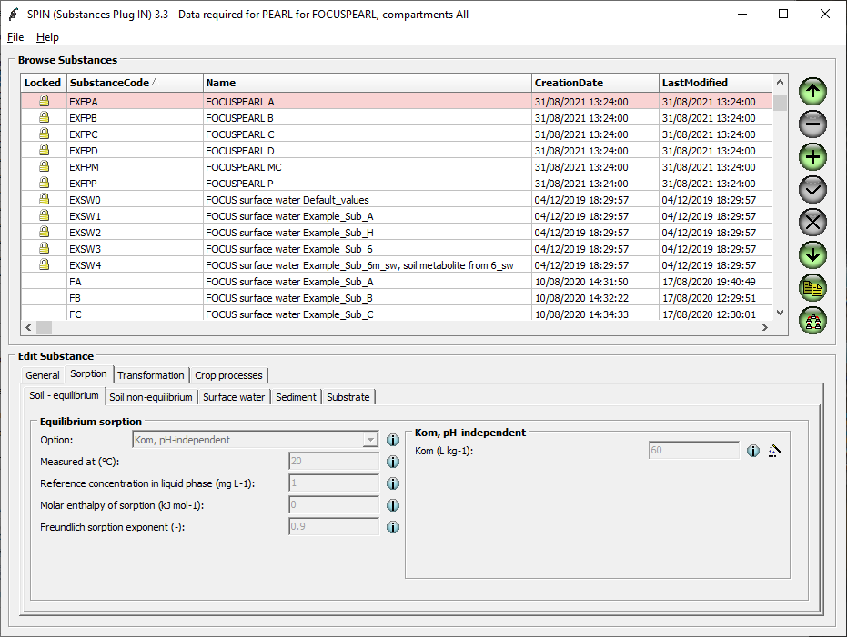
1. Define a substance – sorption data
In this form enter the sorption data (Tab: Soil - equilibrium).
Further information about which value should be entered is given in
https://www.ema.europa.eu/en/documents/other/questions-answers-implementation-cvmp-guideline-environmental-impact-assessment-veterinary-medicinal_en.pdf

Slide 18
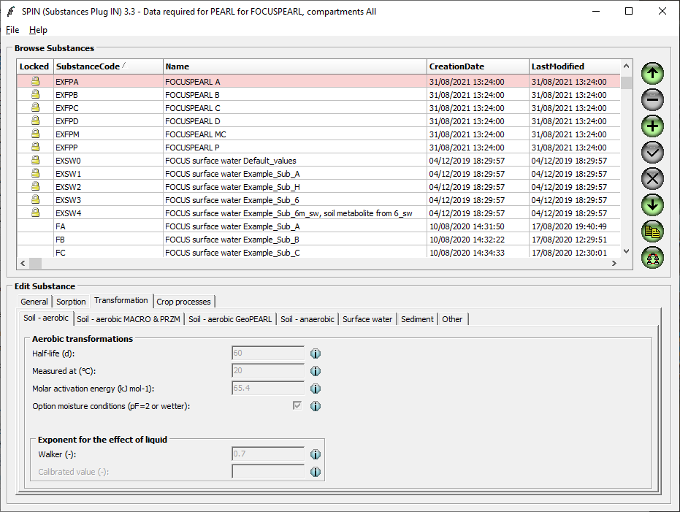
1. Define a substance – transformation data
In this form enter the degradation data (Tab: Soil - aerobic).
Only the half-life (d) is relevant.
Enter the geomean if more than 3 OECD studies are available, enter the minimum value if this is not the case.

Slide 19
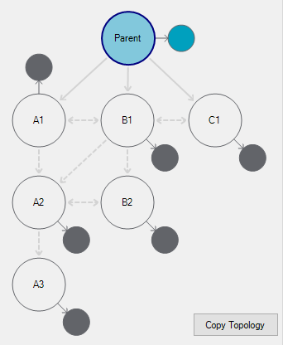
Half lives are obtained based on kinetic models and software recommended by FOCUS deg. kinetics
Further information about how to do the fitting is explained in
https://esdac.jrc.ec.europa.eu/projects/degradation-kinetics

Slide 20
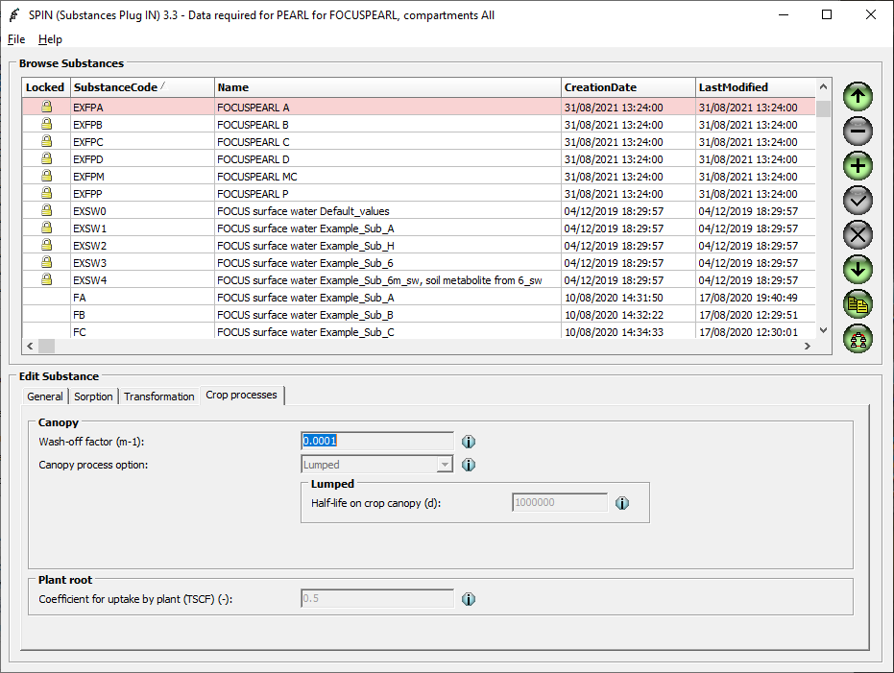
1. Define a substance – crop related data
In this form enter the crop data.
Only the plant uptake factor is of relevance (default =0).

Slide 21
Plant uptake is not a sensitive parameter
Scenario | PEARL (no plant uptake, µg/L) | PEARL (including plant uptake, µg/L)
Châteaudun | 40.40 | 37.08
Hamburg | 143.09 | 128.46
Jokioinen | 166.82 | 122.98
Kremsmünster | 67.77 | 59.86
Okehampton | 91.41 | 87.47
Piacenza | 69.02 | 59.54
Porto | 75.51 | 73.58
Sevilla | 14.12 | 13.77
Thiva | 22.94 | 20.47
Only minor deviations within scenarios are observed

Slide 22
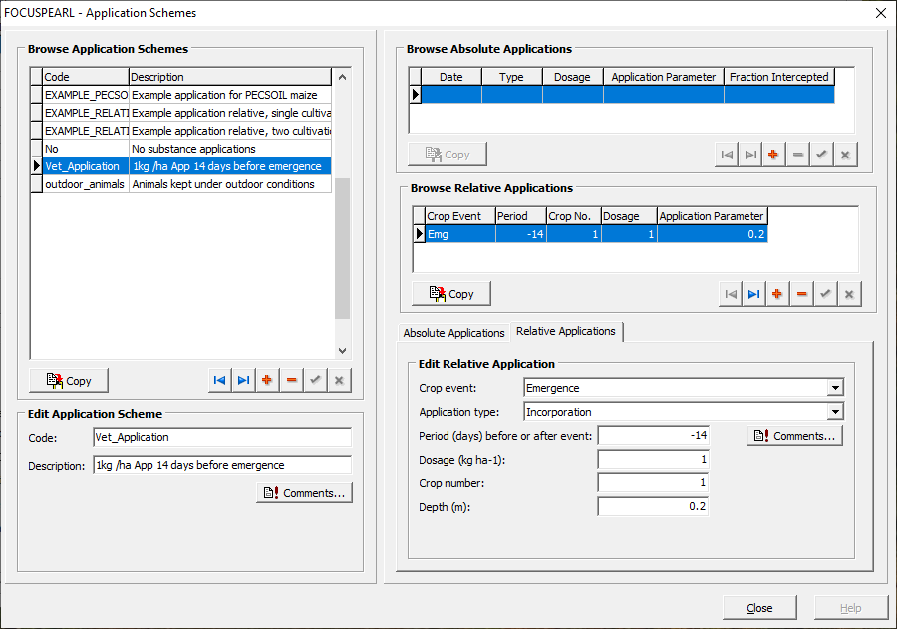
2. Define an application
In this form create a record, then select “relative applications” and enter “-14” (For Okehampton this would give October 3).
With regard to the application depth use “0.2 m”. Finally enter the rate.

Slide 23
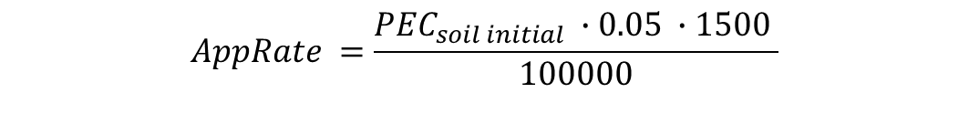
Initial soil concentration can be transformed to AppRate
As the FOCUS models require an application rate rather than an initial soil concentration, the following transformation has to be made:
$$AppRate =\frac{{PEC}_{soil initial} ∙0.05 ∙1500 }{100000}$$
AppRate Application rate as input parameter for FOCUS modelling (kg ha⁻¹)
PEC_{soil initial} Predicted Environmental Concentration in soil [μg kg⁻¹]
1500 Bulk density of dry soil [kg m⁻³]
0.05 Depth of penetration into soil [m]
100000 Conversion factor [kg ha⁻¹ / µg m²]

Slide 24
An application depth of 20 cm represents the realistic worst case for leaching to groundwater
Scenario | PEARL (20 cm incorporation depth, µg/L) | PEARL (5 cm incorporation depth, µg/L)
Châteaudun | 40.40 | 28.71
Hamburg | 143.09 | 135.88
Jokioinen | 166.82 | 133.48
Kremsmünster | 67.77 | 55.48
Okehampton | 91.41 | 86.16
Piacenza | 69.02 | 59.57
Porto | 75.51 | 74.63
Sevilla | 14.12 | 5.37
Thiva | 22.94 | 16.22
The table shows that higher concentrations are obtained with an application depth of 20cm compared to 5 cm within all scenarios

Slide 25
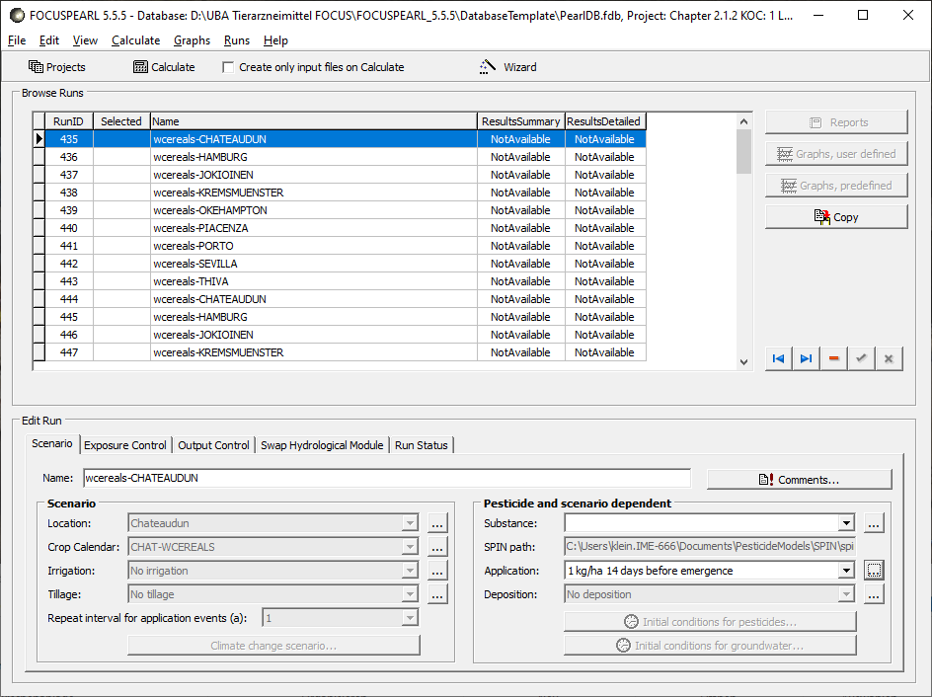
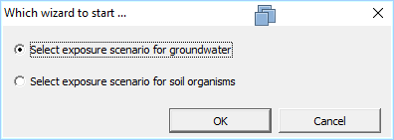
3. Create a new project
New projects can be created by using the FOCUS-Wizard. Always the (preselected) groundwater simulations have to be accepted after clicking at Wizard.
3

Slide 26
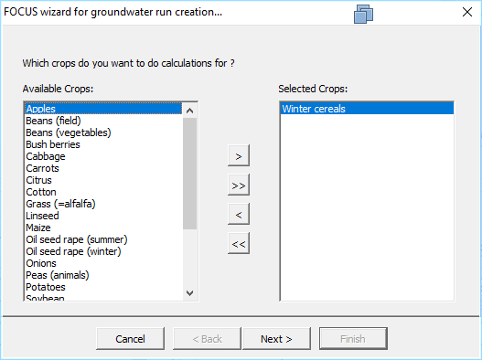
3. Create a new project – select crop(s)
In this form the crop has to be selected (normally: winter cereals).
3

Slide 27
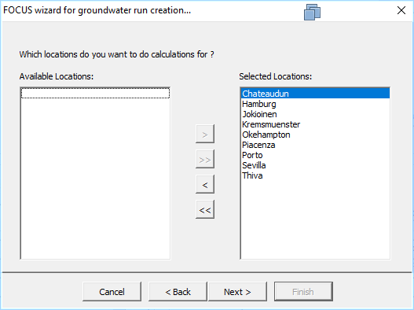
3. Create a new project – choose locations
In this form the locations have to be selected.
Hamburg, Jokioinen, Piacenza and Okehampton represent worst cases.
The current CVMP guideline recommends to use the Okehampton scenario.
3

Slide 28
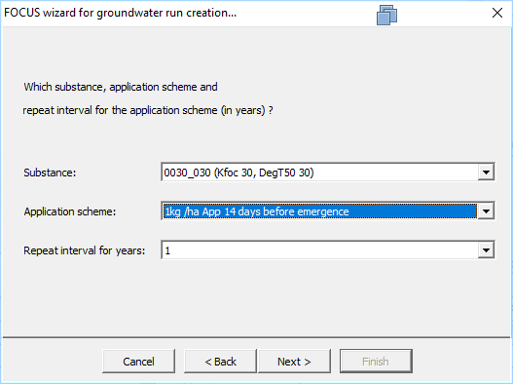
3. Create a new project- select application
In this form substance and application scheme have to be selected.
3

Slide 29
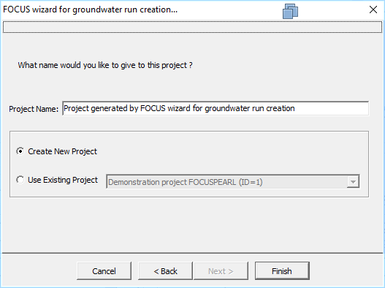
3. Create a new project - select name of project
In the final form the new project should be named or added to an existing project.
3

Slide 30
4. Start calculation
At this stage the simulation can be started. The selected entries in this form are considered for the simulations.
3

Slide 31
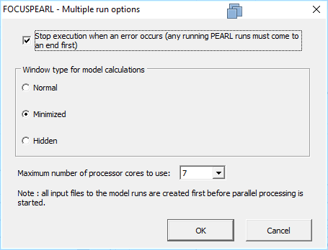
4. Start calculation - start multiple runs in parallel
Most relevant in this form is the last option. Parallel PEARL runs will be started dependent on the number here. You should consider values below the number of cores.
Normally the value suggested here already considers the actual number of processor cores.
3

Slide 32
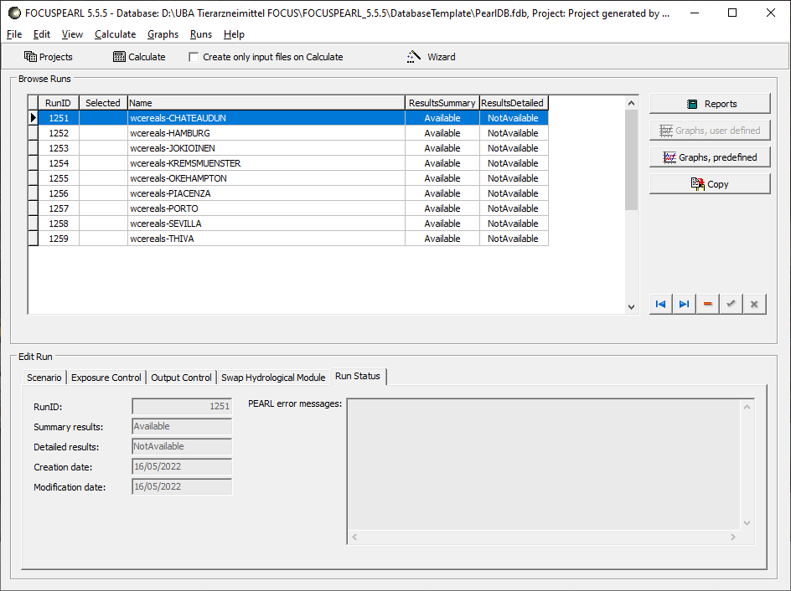
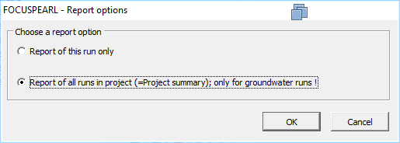
5. Find the results
At this stage the results of the simulations can be checked. It is possible to select report of a single run or all runs.
3

Slide 33
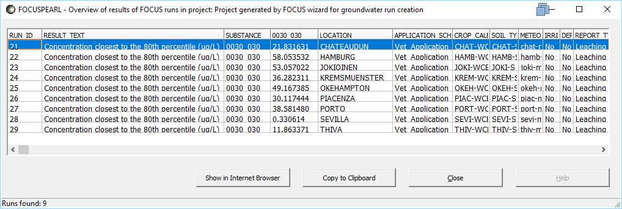
5. Find the results – combine all runs in one table
In case the user selected „all runs in project“ the results are presented in a table.
3

Slide 34
Working with FOCUS SW models

Slide 35
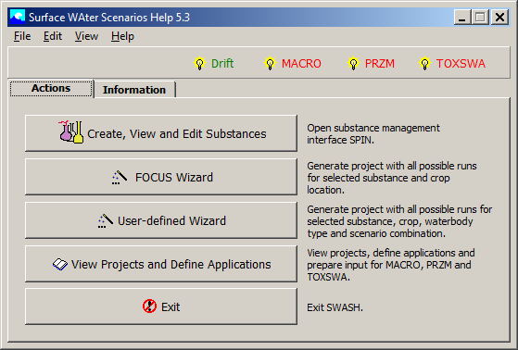
A central shall combines several SW models
The central shell SWASH has to be used.
It is recommended to follow a fixed sequence.
4
5
6
1
2
86897
3

Slide 36
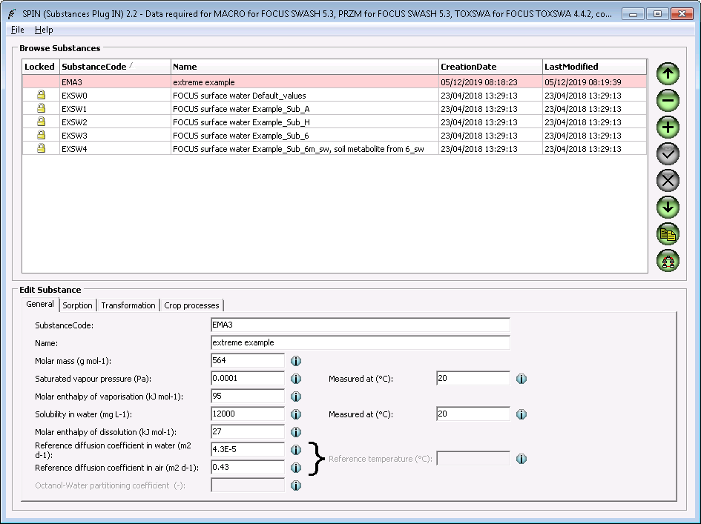
1. Create a substance - general data
Copy record (e.g., EXFPA) and enter the PC-Data. It is the same database as in FOCUS PEARL (Spin). It does not matter whether PEARL or SWASH is first used when a substance is defined.

Slide 37
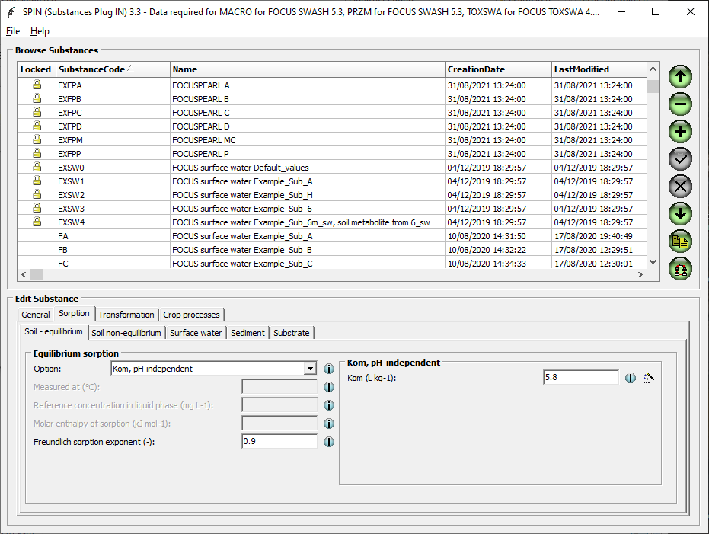
1. Create a substance - sorption data
In this form enter the sorption data (Tabs: Soil- equilibrium, Surface water and sediment). The same values should be entered for all three tabs. Further information about which value should be entered is given in
https://www.ema.europa.eu/en/documents/other/questions-answers-implementation-cvmp-guideline-environmental-impact-assessment-veterinary-medicinal_en.pdf

Slide 38
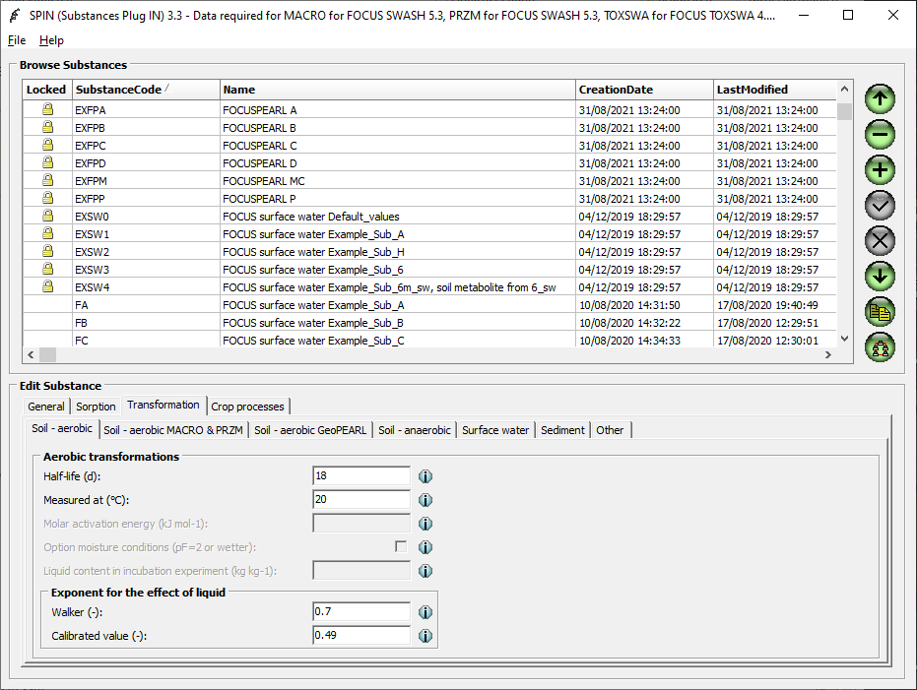
1. Create a substance - transformation data
In this form enter the degradation data (Tabs: Soil – aerobic MACRO & PRZM, Surface water and sediment). Only Half-life is relevant. For MACRO&PRZM the same value should be entered as for PEARL.
Enter 1000 d if no results are available.

Slide 39
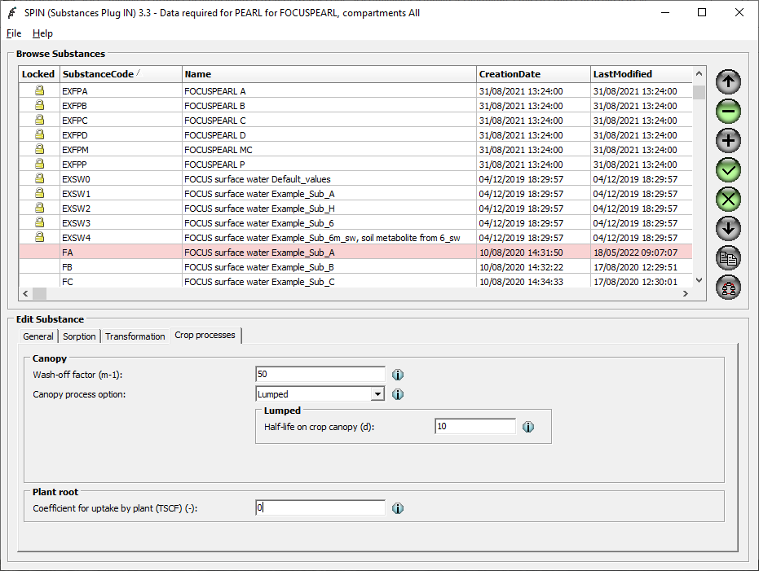
1. Create a substance - crop processes
In this form enter the crop related data.
Only the Plant uptake factor is relevant. Should be set to zero.
The other parameters are not relevant since the substances are incorporated.

Slide 40
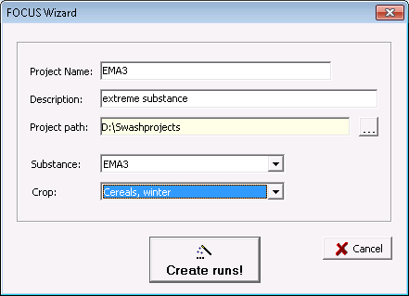
2. Create a new project
In step 2 the project has to be defined by selecting the substance and the crop (normally winter cereals).

Slide 41
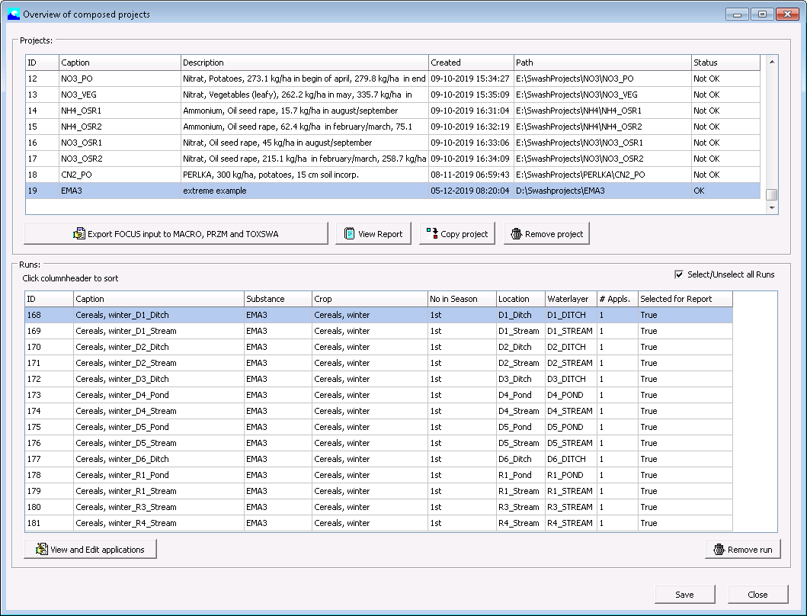
3. Define an application
In step 3 the application pattern is defined. When this form is loaded click at „View and Edit applications“.

Slide 42
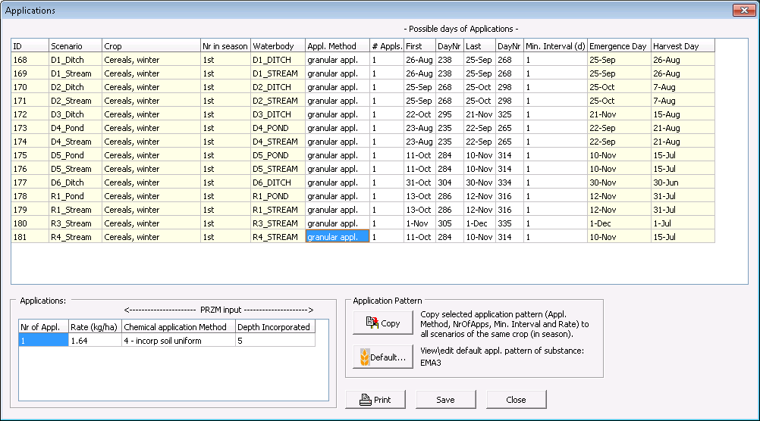
3. Define an application
First, enter granular application for every run in the project. Then select one of the R-scenarios and edit the respective fields followed by „copy“.

Slide 43
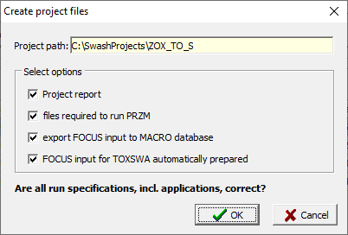
3. Define an application – export to simulation models
Then the results should be exported to the 3 simulation models (MACRO, PRZM, TOXSWA) by clicking at the respective button.

Slide 44
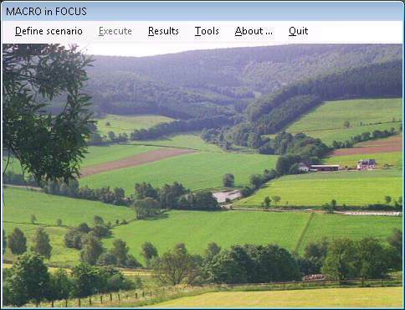
4. Working with MACRO in FOCUS (Drainage)
Macro is loaded when the respective button is used. First the scenario has to be set.

Slide 45
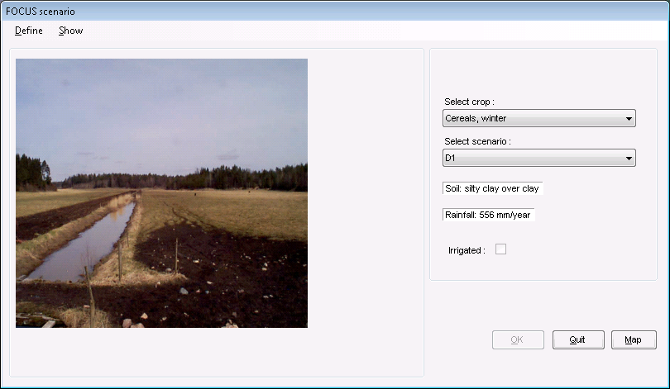
4. Working with MACRO in FOCUS (Drainage)
Normally winter cereals is used together with one of the D scenarios (e.g., D1). Then click at „Define“ to set the substance and the application pattern.

Slide 46
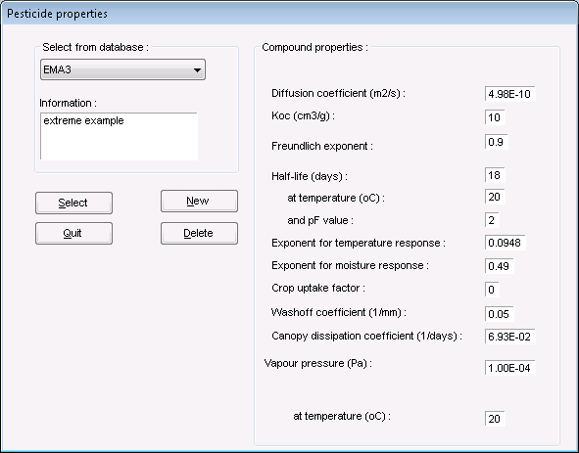
4. Working with MACRO in FOCUS (Drainage)
Select the parent compound here.

Slide 47
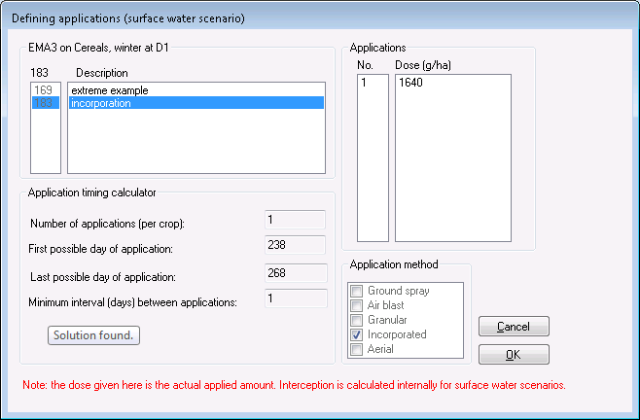
4. Working with MACRO in FOCUS (Drainage)
In this step the applications have to be defined. Pick the suitable pattern. It is the same information as exported previously out of SWASH.

Slide 48
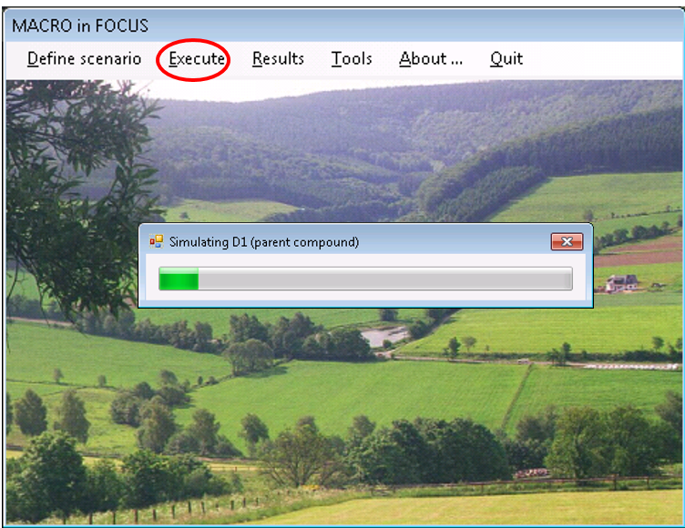
4. Working with MACRO in FOCUS (Drainage)
Now, a simulation can be performed. Use the menu item “Execute” followed by “current” (see Figure 32).

Slide 49
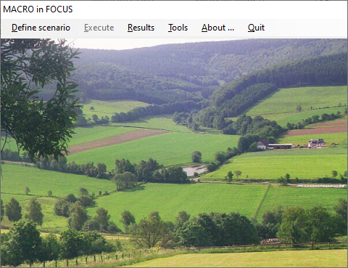
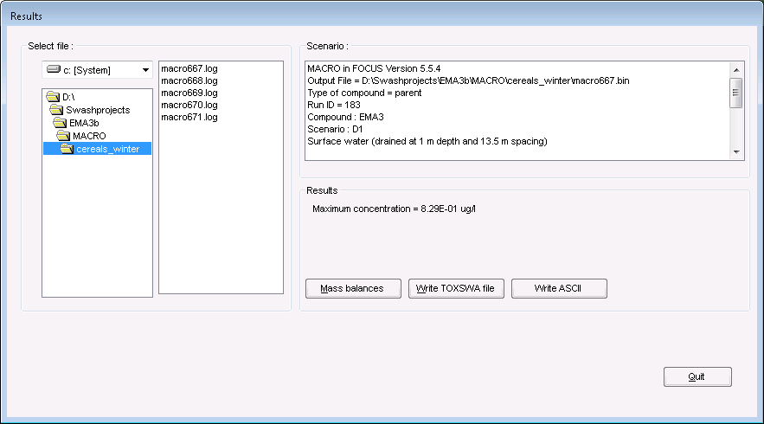
4. Working with MACRO in FOCUS (Drainage)
Now the results can be exported to TOXSWA (Menu item Results). Select a log file and click at “Write TOXSWA file”.

Slide 50
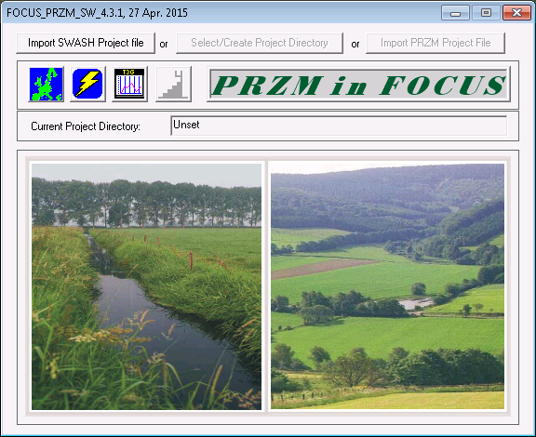
5. Working with PRZM in FOCUS (Run-Off)
In step 5 the run-off simulations are performed (PRZM). In order to load the information from SWASH use the button “Import SWASH Project file”

Slide 51
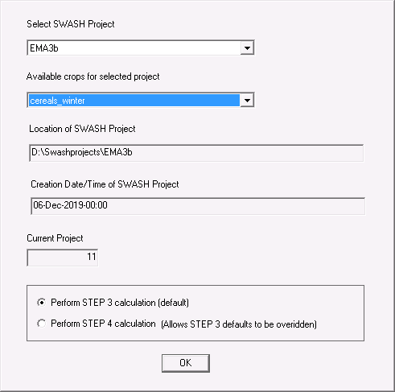
5. Working with PRZM in FOCUS (Run-Off)
Select the respective SWASH Project. Do not use the other options. Click directly at OK.

Slide 52
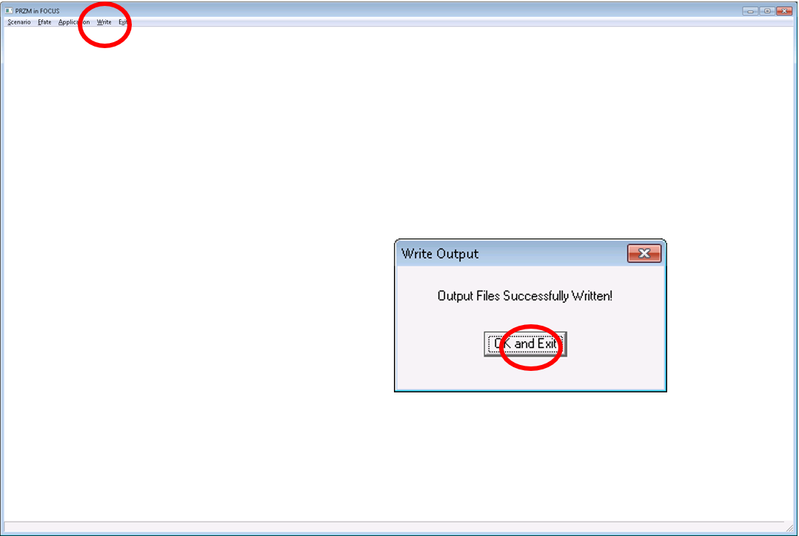
5. Working with PRZM in FOCUS (Run-Off)
When this form is loaded use “Write” followed by “OK and Exit”. Now, all information for the PRZM is loaded.

Slide 53
5. Working with PRZM in FOCUS (Run-Off)
Run PRZM by clicking at the lightning. Then the form can be closed.

Slide 54
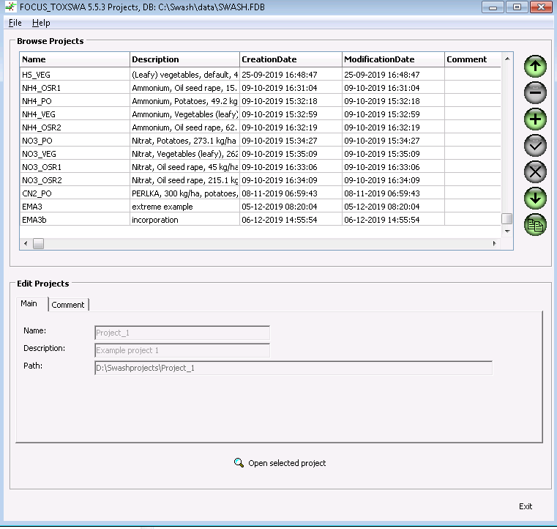
6. Working with TOXSWA in FOCUS
In the final step 6 TOXSWA is used. The models always starts with the list of all projects. In order to perform simulations a project must be picked first.

Slide 55
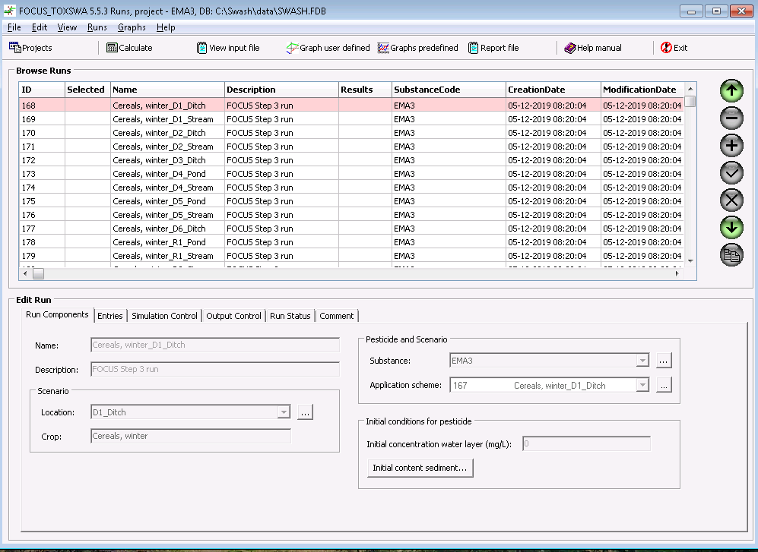
6. Working with TOXSWA in FOCUS
After choosing a project a detailed list of all runs is loaded. The model only considers selected scenarios for simulations. Use “Calculate” to start.

Slide 56
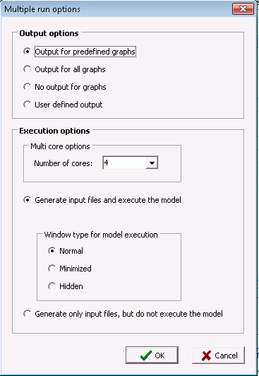
6. Working with TOXSWA in FOCUS
The most important run option is the number of processor cores. It determines the number of parallel TOXSWA runs. Normally the value suggested here already considers the actual number of processor cores.

Slide 57
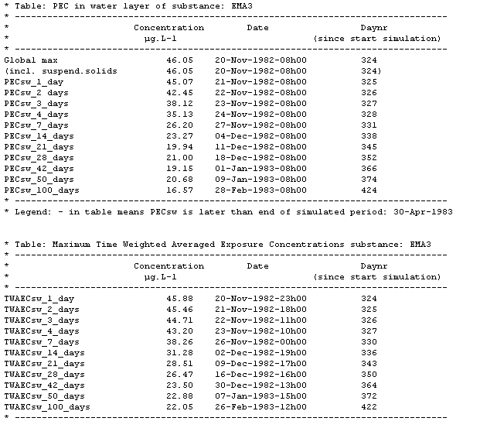
6. Working with TOXSWA in FOCUS
After the simulations the results can be evaluated by selecting a simulation and clicking at „Report file“. The important information is at the end of the file. Normally the PECmax is the relevant endpoint (maximum of 1 year).
See Q & A Q 17 for cases when
Time weighted average (TWA)
can be used.

Slide 58
Outlook – Only minor impacts from FOCUS repair action expected
In principle many changes can be expected as outcome of the FOCUS repair action. However, only a single one is relevant for veterinary compounds.
Increase of the simulation period from 1 to 20 years (same as PEARL)
Intention: more reliable run-off and drainage calculations.

Slide 59
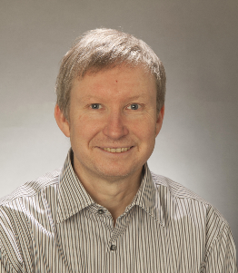
Thank you very much for your attention!
Dr. Michael Klein
Fraunhofer IME
Auf dem Aberg 1
57392 Schmallenberg
Germany
Michael.Klein@ime.fraunhofer.de

